Slide 1
Programmable TLS Meter (Temperature Light Sound)
By William Kommritz
PROJECTS - EET H294 – 01
May 6, 2014

Slide 2
What is the TLS Meter
Temperature, light and sound measurement device
Serial computer interface
Light counter with count/min and count/sec
Sound counter with count/min and count/sec
Linear VU meter
Unlimited possibilities if reprogrammed

Slide 3
TLS Meter Capabilities
2 line 16 character LCD screen
3 LED indicators (2 are have PWM ability)
-13 to 212 degree F temperature range
Linear light level 0 to 999 (no units)
Linear sound level 0 to 999 (no units)
Serial, SPI and 3 GPIO expandability
32KB program memory (9668b used)

Slide 4
Future Expansions
Piezoelectric buzzer or speaker
Wireless communication (serial Bluetooth)
SD card for logging sensor data
Bigger screen LCD screen (20x4 or graphical)
Expansion port for external sensors
Connectors for controlling servos and motors

Slide 5
Problems Encounters
ORCAD capture and layout is frustrating
Input button holes were too small
DC barrel jack holes were too small
Very easy to write the program code
To tempting to write all possible functions

Slide 6
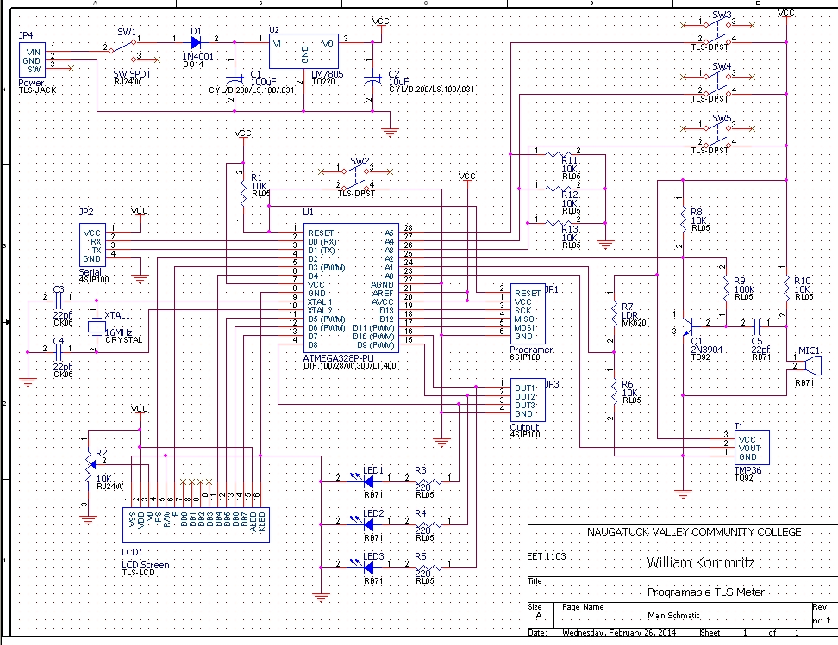

Slide 7
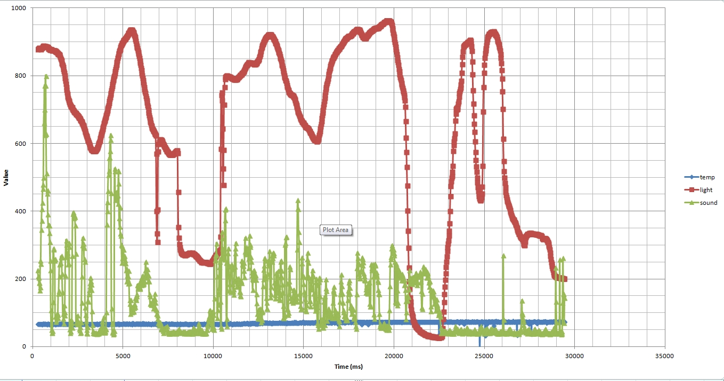
Sample Test Data

Slide 8
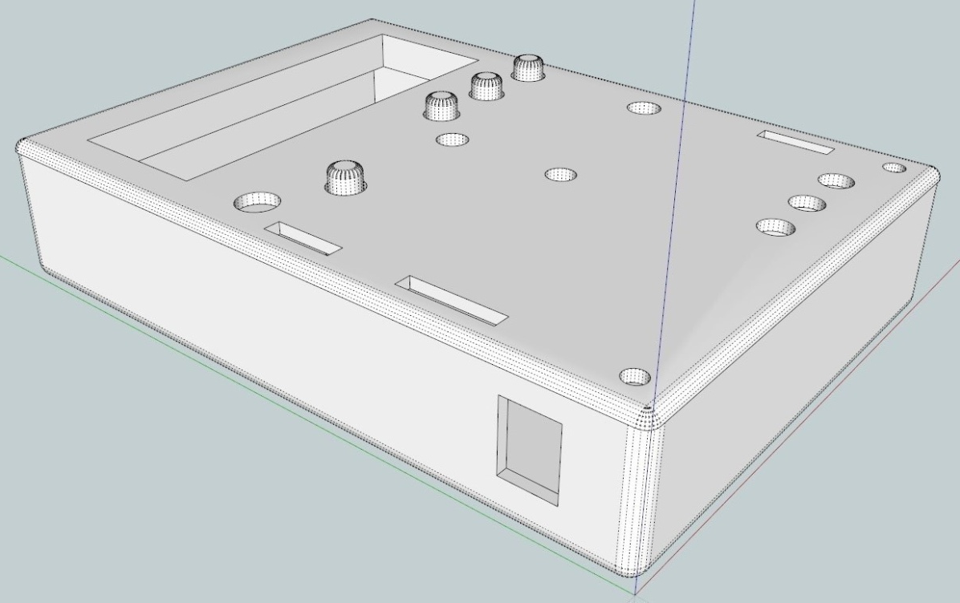
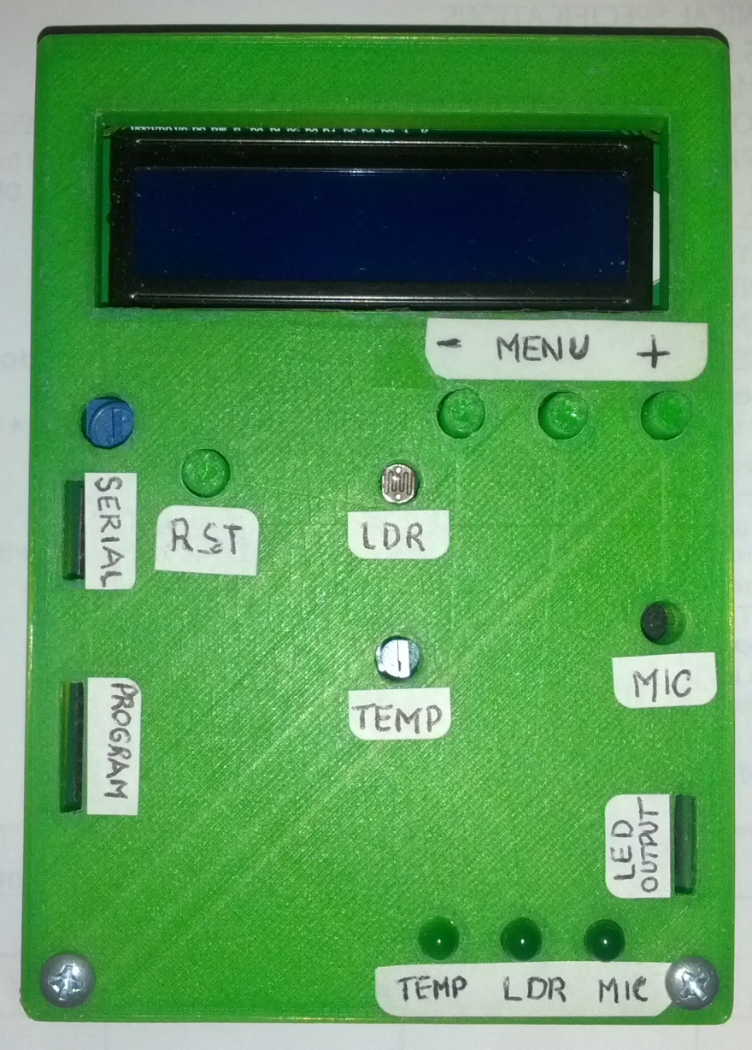
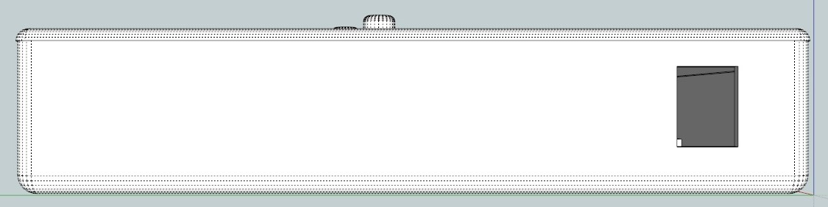

Slide 9
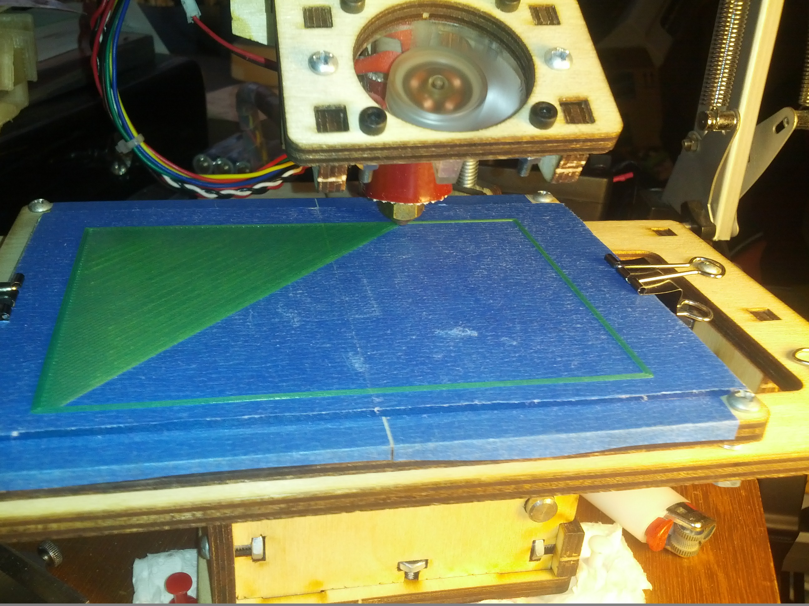

Slide 10
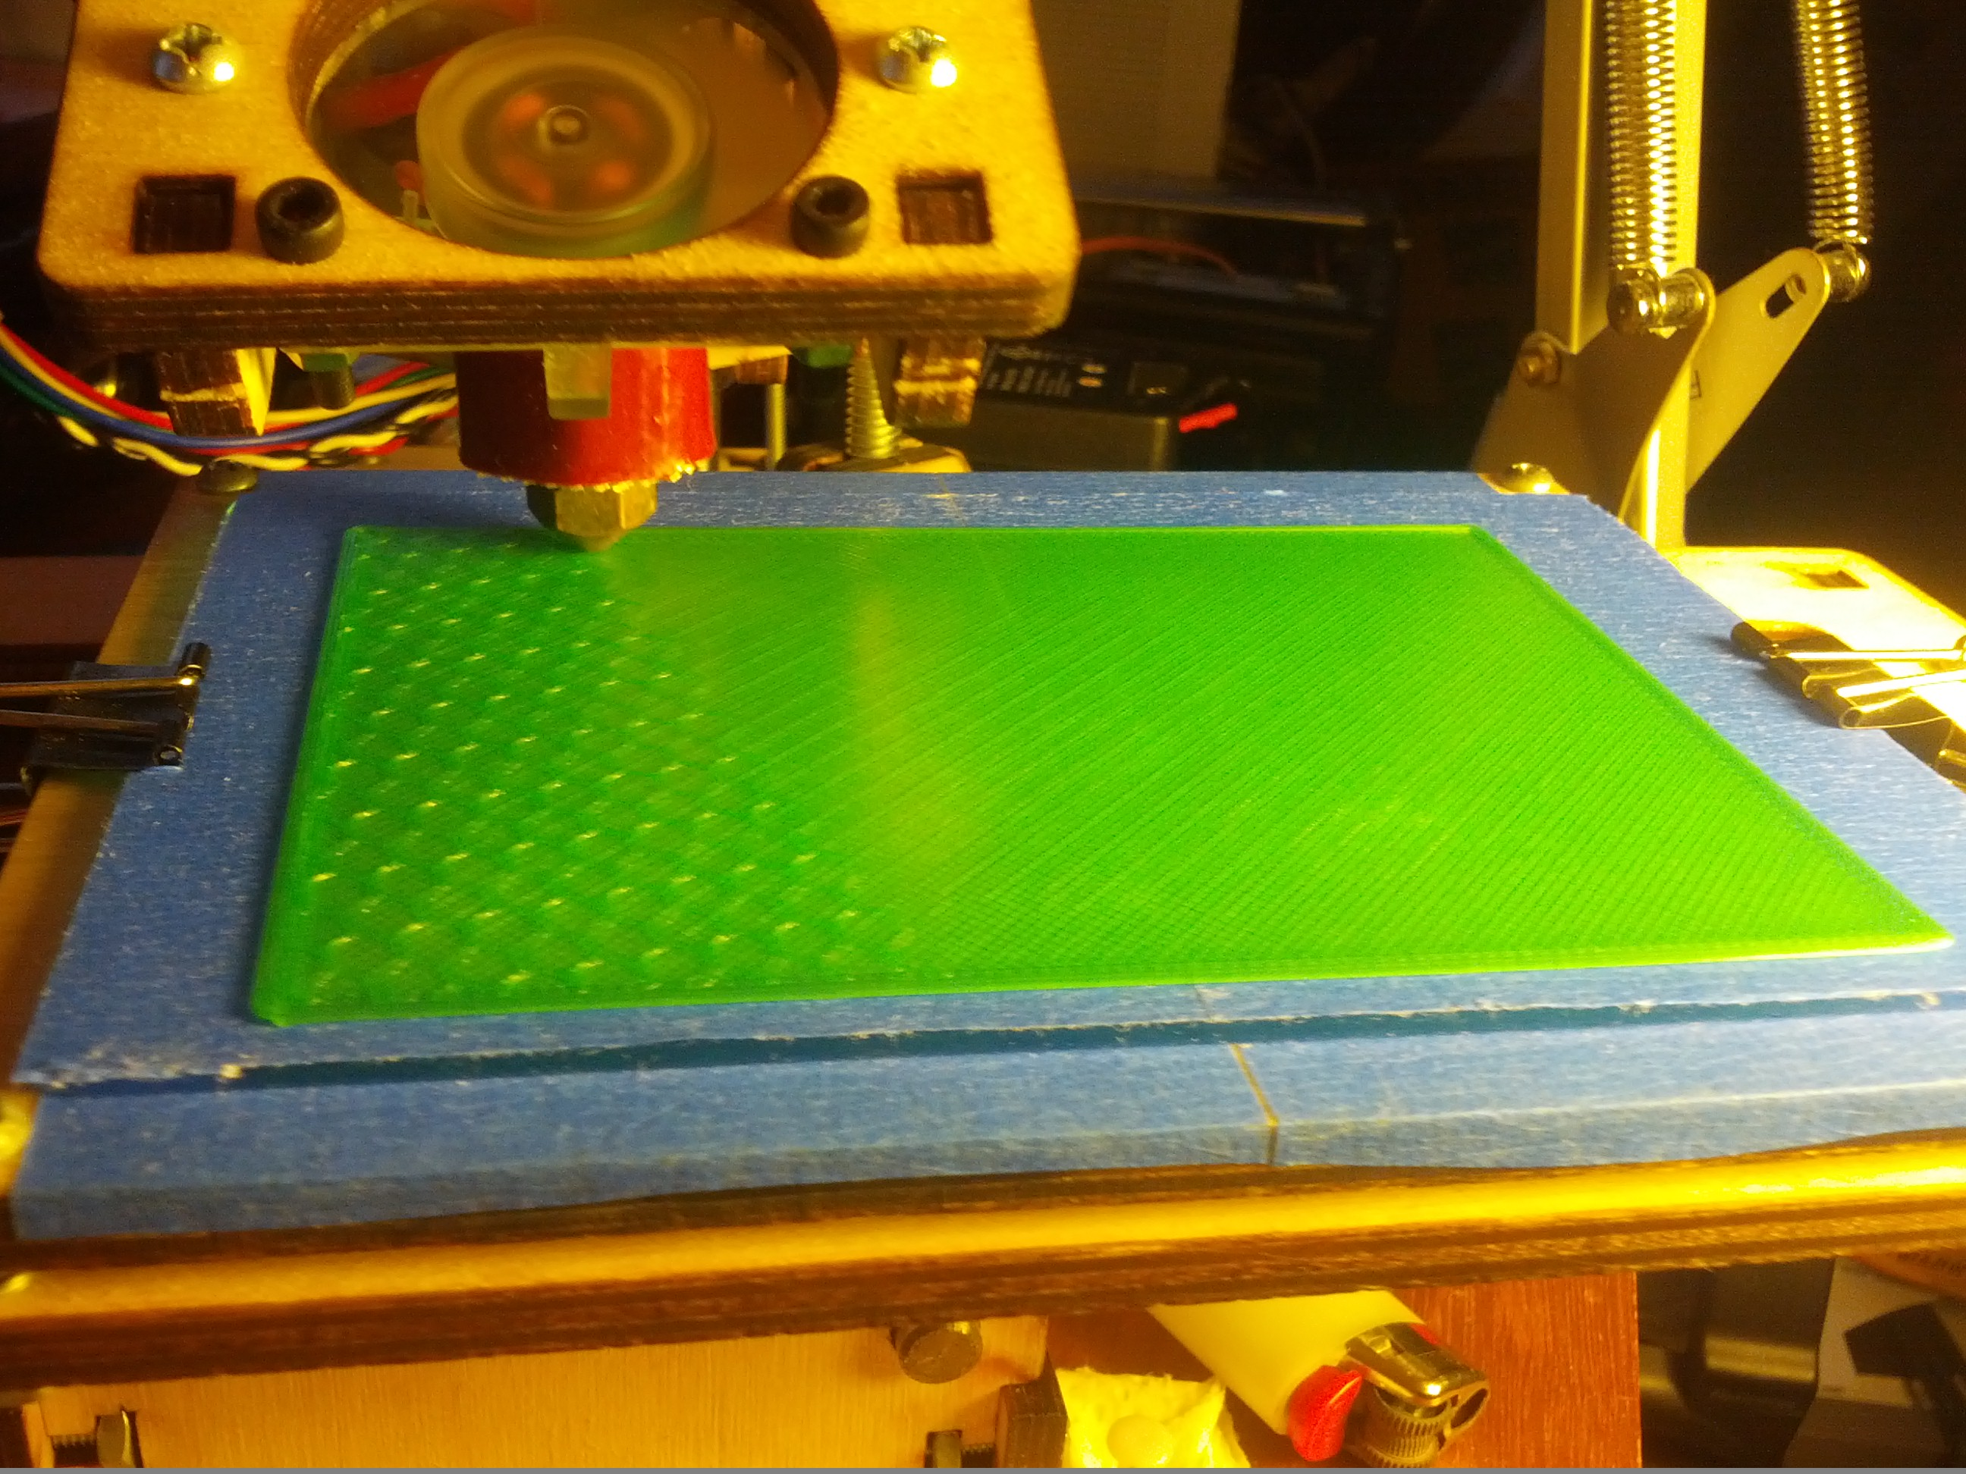

Slide 11
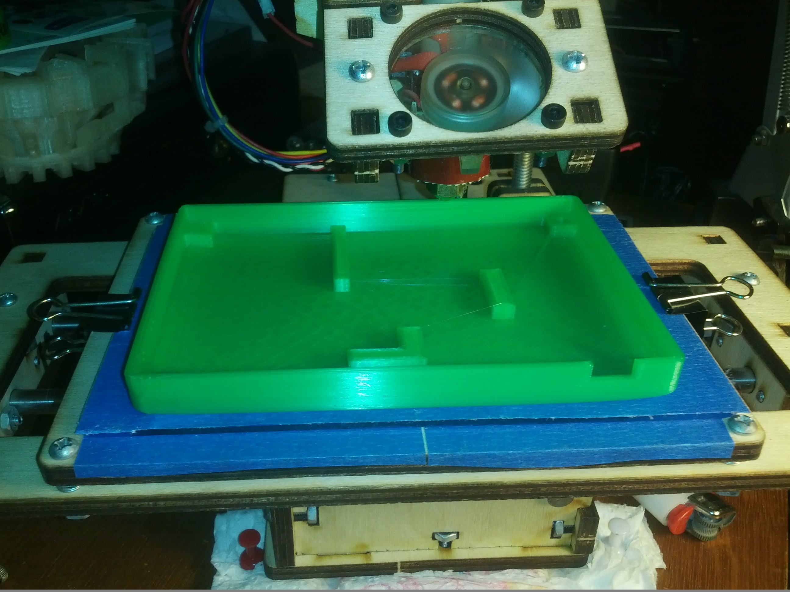

Slide 12
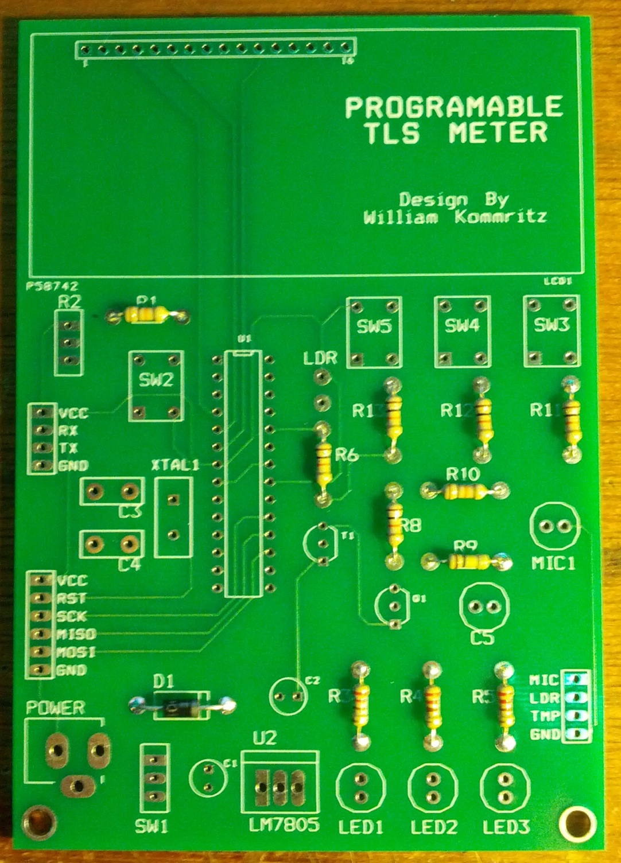
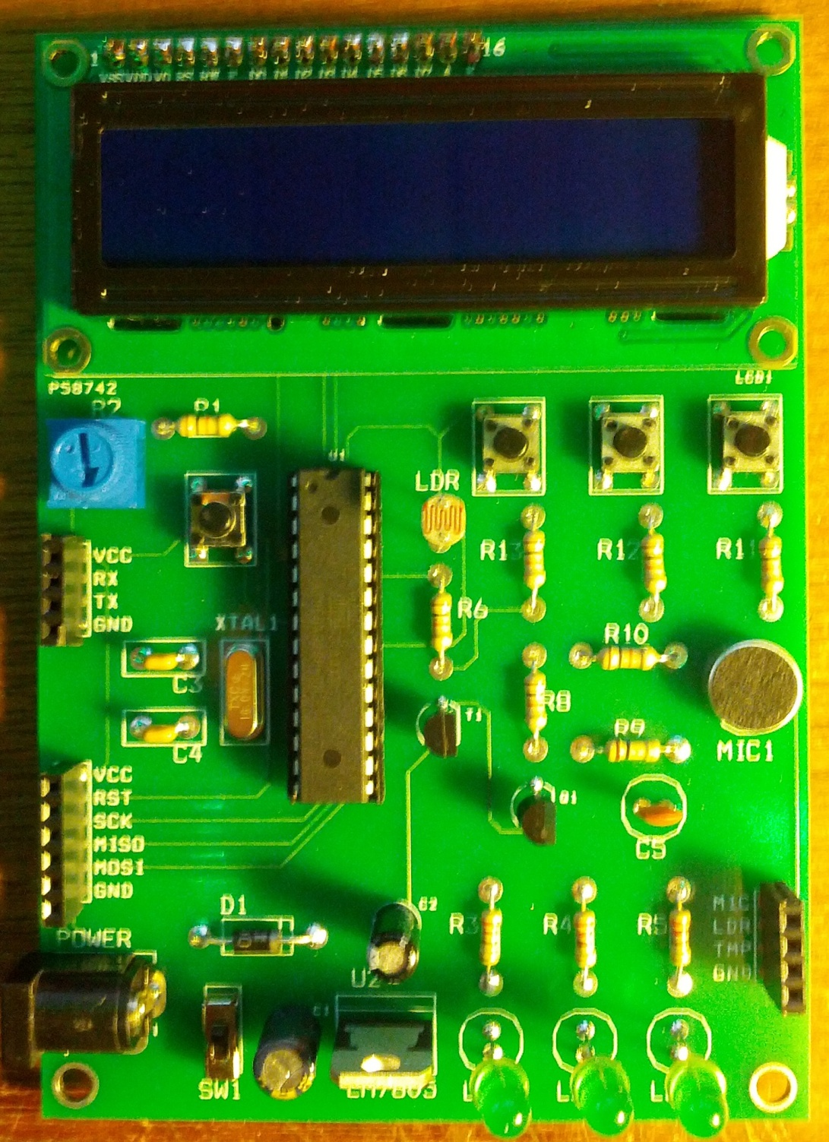

Slide 13
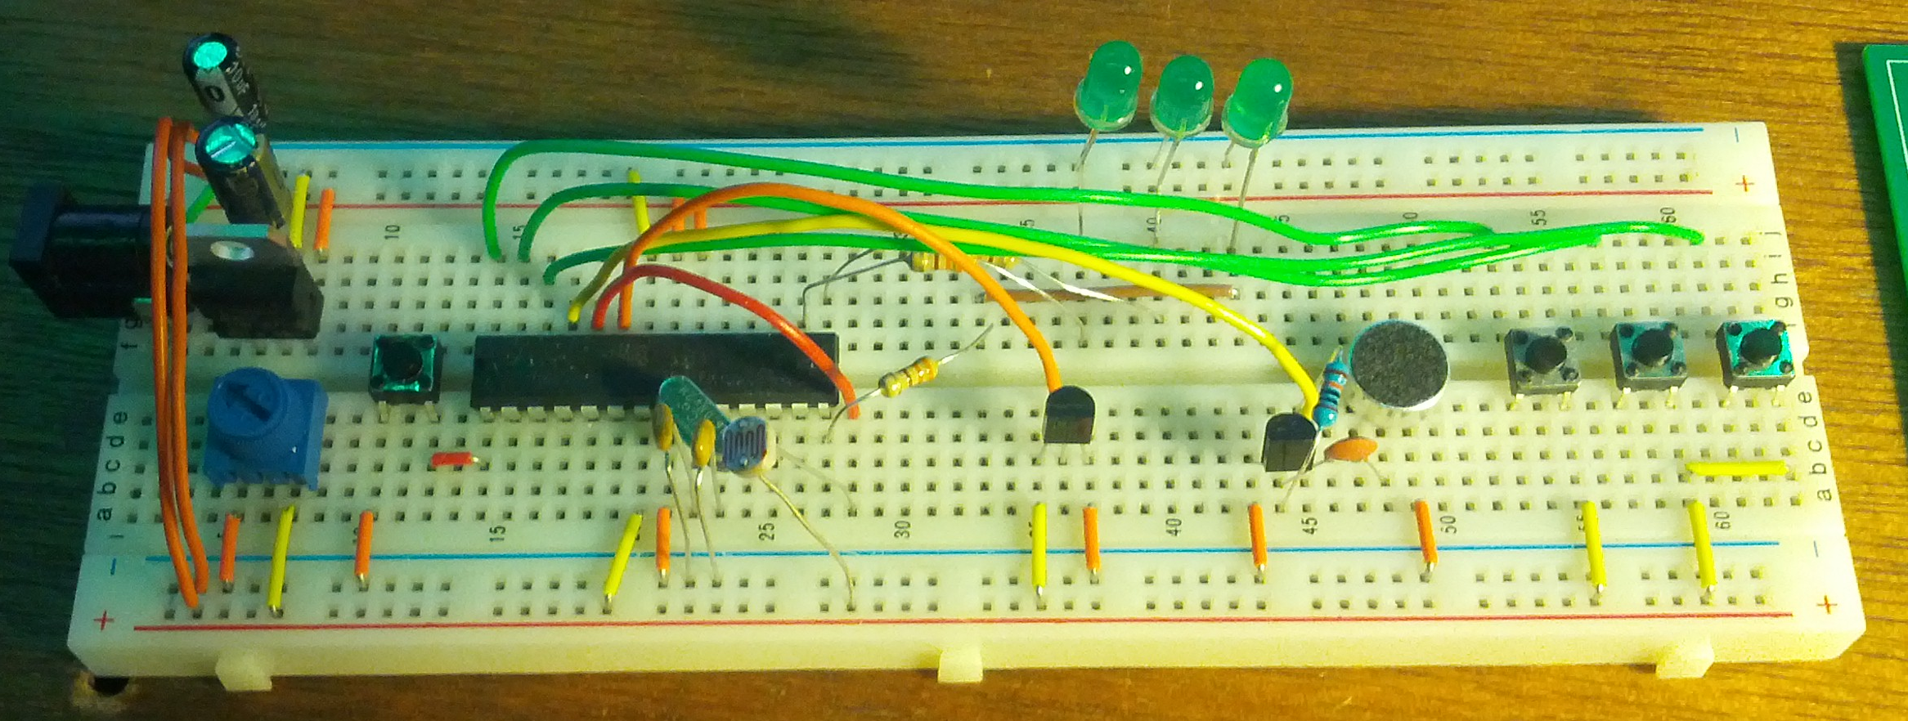

Slide 14
Interesting Facts
Count up to 2500 counts per second sec in light counter mode (150K rpm) 4% accuracy
568 lines of code
9,662 of 32,256 bytes of program space
Minimum program cycle speed of 15ms
Case took 4.75 hours to print

